Slide 1


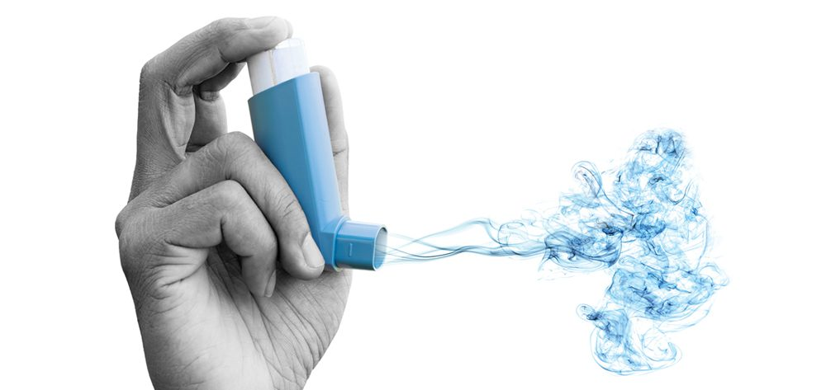

11th September 2023
0
SAMSUNG AI course 2022 @ NOVA University
MYBREATH
An Assistant app for your breathing issues
Plan better with us
Group:
Amin Khodamoradi
Ana Carolina Pádua
Joana Seringa
Zabya Abo Aljadayel

Slide 2
What is the problem
Breathing issues affect millions worldwide and it’s growing
262 million with asthma and 455000 deaths acc to WHO
0.5 to 0.7 million asthma in Portugal acc to ine.pt
What they need:
Lak of the right resources to find their triggers
What we offer:
Personalized recommendations based-on her/his location

Slide 3


The Problem & The Solution
people with asthma visit Hospital Emergency department when thier chronic condition gets worse.
Elevated Healthcare expenditures
Machine Learning model to predict the risk of an emergent admission from people with asthma
Bad patient experience

Slide 4
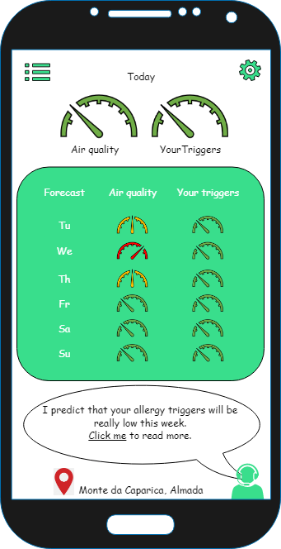

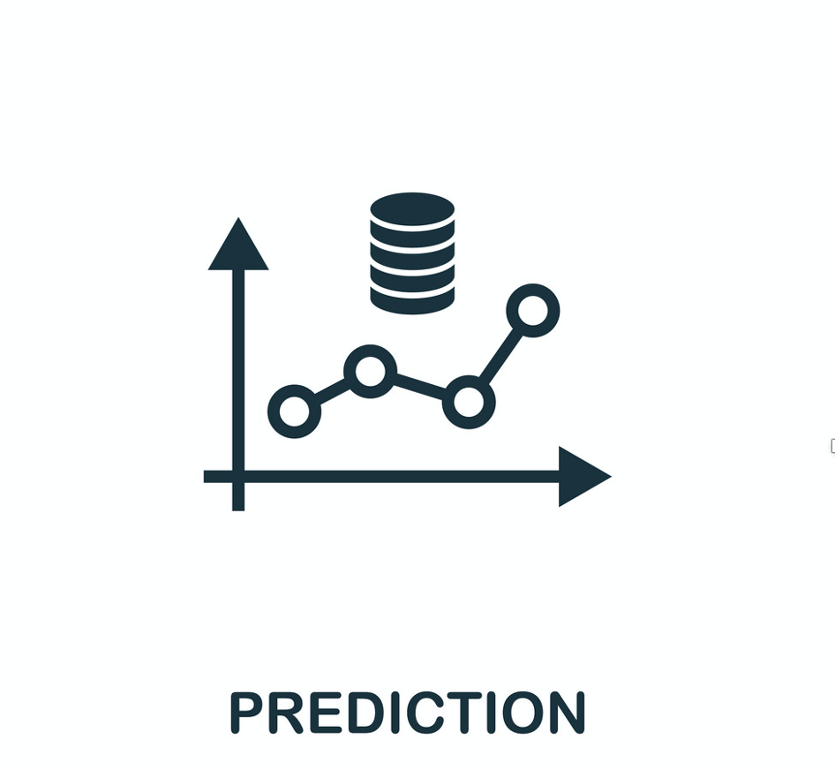





Solution
Wheather
Pollen
Pollution
Hospital data
User feedback
FEEDBACK
COLLECTION

Slide 5
Methods
Asthma admissions
Pollen
Weather
Pollution
Random Forest Model
Logistic Regression
SVM
LDA
XGBoost
...
Problem definition
Data Collection
Data Preparation
Model Selection and Implementation
Model Evaluation
Exploratory Data Analysis
Data Cleaning
Feature Engineering
Precision
Recall
F1-score weighted
MSE

Slide 6
Data Collection and Integration
Admission Data
Hospital Sao Francisco Xavier
#1,762 URG asthma admissions from first of January 2019 to 29 November 2022
We excluded data after March 2020 to 2022, because of COVID-2019
Weather data
Extraction the respective data directly from the website.
Pollution data
Extraction the respective files directly from the website.
Pollen data
We created a dedicated script that used beatifullsoap for pulling data out of
Data Integration
Data from admissions, pollen, weather and pollution were integrated in a single file, based on date (weather).

Slide 7
Data Cleaning
Elimination of variables with more than 30% of missing values
Pollution data: replacement of missing values with zeros
Elimination of other variables that were not relevant for the problem under analysis or had the same value for all the episodes.

Slide 8
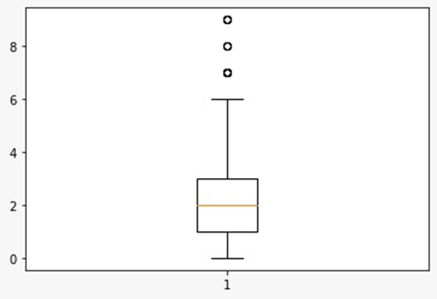
Exploratory Data Analysis
Number of Admissions | Number of days
0 | 126
1 | 183
2 | 180
3 | 133
4 | 82
5 | 45
6 | 24
7 | 9
8 | 3
9 | 4
Admission number box plot
Daily distribution of the number of admissions
Defining the problem as classification with two target level of low (<=2), high (>2)

Slide 9
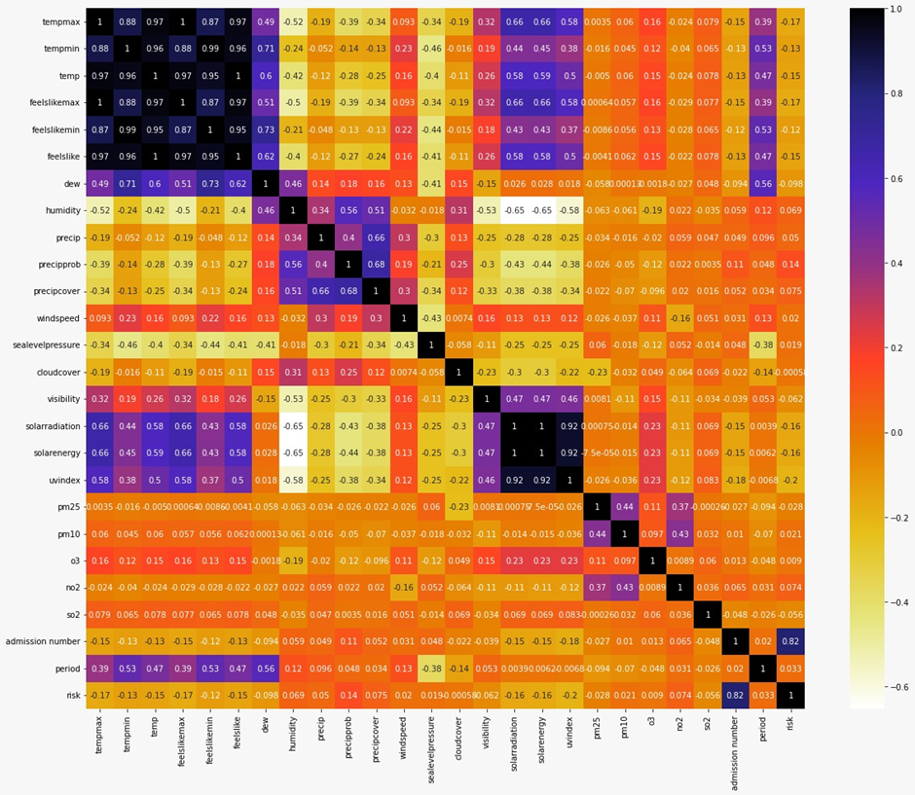
Exploratory Data Analysis
Correlation table

Slide 10
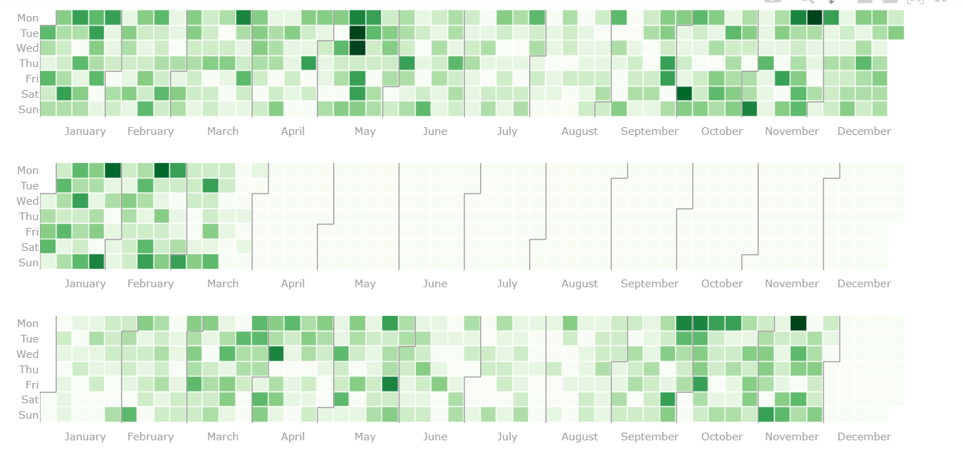
Exploratory Data Analysis
Admission
number

Slide 11
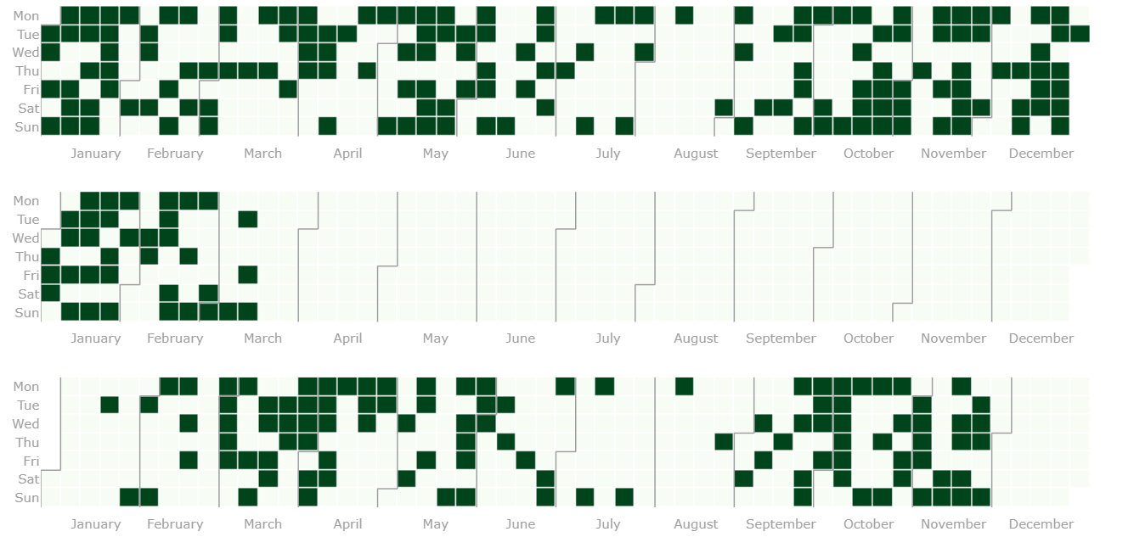
Exploratory Data Analysis
Risk
level

Slide 12
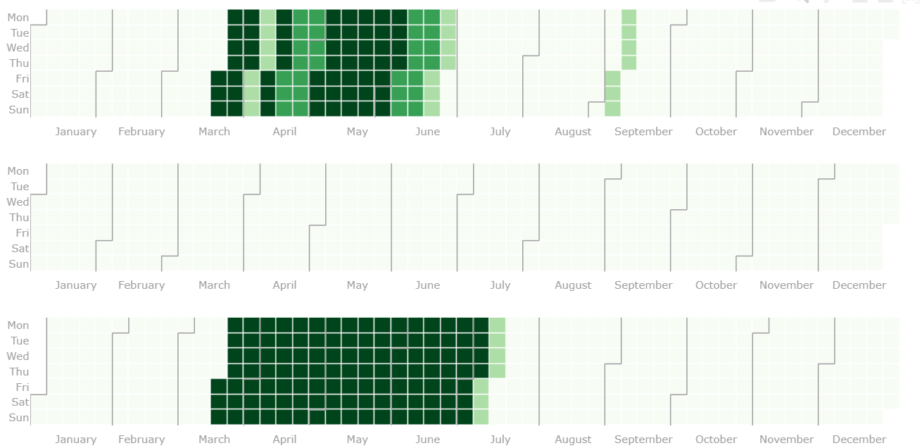
Exploratory Data Analysis
Pollen
Data

Slide 13
Feature Engineering
Data split
Dataset: TimeSeries
Training set: 80 %
Test set: 20 %
Training set
Validation set
Training set
Validation set
Training set
Validation set

Slide 14
Feature Engineering
Feature Selection
Stepwise feature selection: (backward and forward), implemented on R (file named Stepwise feature selection(backward and forward).R)
Mutual Information: which is a quantity that measures a relationship between two random variables that are sampled simultaneously, and that showed no linear correlation.
L1-based feature selection: which removes features with low variance.

Slide 15
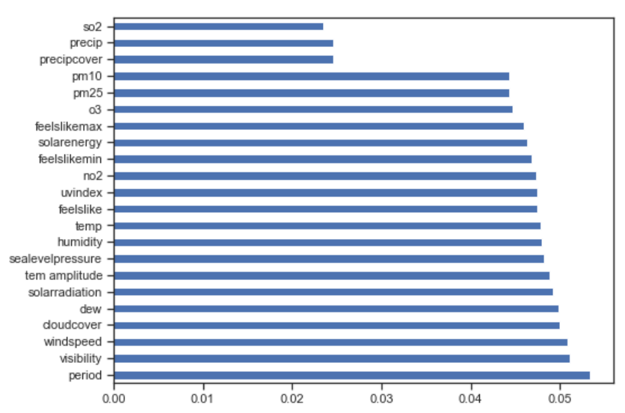
Feature Engineering
Feature Selection
● Chi-square test, which is a statistical hypothesis test used when the sample sizes are large to examine whether two categorical variables are independent in influencing the test statistic. We evaluated that based on the F_score and p value.
● Extra tree feature importance to decide which variables are important to be included in the model.
After trying all the methods mentioned above we selected the Chi-square test with criteria of p-value < 0.05.

Slide 16

Input Variables
Weather
Pollution
Precipprob
Solarradiation
Precipcover
Precip
So2
Pm25
UVindex
8. Feelslikemax
9. No2
10. Feelslike
11. Humidity
12. Temp
13. Feelslikemin
14. Tem amplitude
Output: Number of asthma admissions

Slide 17
Classification
We explored several ML algorithms for supervised learning: Logistic Regression Decision Tree (DT) Linear Discriminant Analysis Gaussian Naive Bayes Support Vector Machines (SVM) Random Forest Sklearn Gradient Boosting XGBoost Classifier XGBoost Random Forest Classifier

Slide 18
Regression
We explored several ML algorithms for Regression: Linear Regression Decision Tree Regression (DT) Random Forest Regression XGBoost Regression XGBoost Random Forest Regression

Slide 19
Model tuning
GridSearchCV for model parameters optimizations
Model | Best score and best parameter(s)
Gaussian Naive Bayes | f1_weighted: 0.555 Config: {'var_smoothing': 0.8111308307896871}
Linear Discriminant Analysis | f1_weighted: 0.574 Config: {'shrinkage': 0.01, 'solver': 'lsqr'}
Decision Tree | f1_weighted: 0.593 Config: {'criterion': 'entropy', 'max_depth': 18, 'max_features': 9, 'min_samples_leaf': 1, 'min_samples_split': 2}
SVC model | f1_weighted: 0.563 C': 100, 'gamma': 1, 'kernel': 'linear'}
Logistic Regression | f1_weighted: 0.571 Config: {'C': 100, 'max_iter': 100, 'penalty': 'l2', 'solver': 'lbfgs'}
F1_score = 2 x (Precision x Recall) / Precision + Recall
Notes:
F1 score was the scoring used. It is the harmonic mean of precision and recall.
var_smoothing is a stability calculation to widen (or smooth) the curve and therefore account for more samples that are further away from the distribution mean.

Slide 20
Model tuning
GridSearchCV for model hyperparameters optimizations
Model | Best score and best parameter(s)
Gradient Boosting | f1_weighted: 0.589 Config: {'learning_rate': 1, 'max_depth': 5, 'max_features': 9, 'n_estimators': 150}
XGBoost Classifier | f1_weighted: 0.536 Config: {'learning_rate': 1, 'max_depth': 6, 'n_estimators': 200}
RFXGBoost Classifier | f1_weighted: 0.570 Config: {'learning_rate': 1, 'max_depth': 1, 'n_estimators': 300}
Random Forest | f1_weighted: 0.539 Config: {'bootstrap': False, 'max_depth': 9, 'max_features': 'auto', 'n_estimators': 200}
F1_score = 2 x (Precision x Recall) / Precision + Recall
Notes:
F1 score was the scoring used. It is the harmonic mean of precision and recall.
var_smoothing is a stability calculation to widen (or smooth) the curve and therefore account for more samples that are further away from the distribution mean.

Slide 21
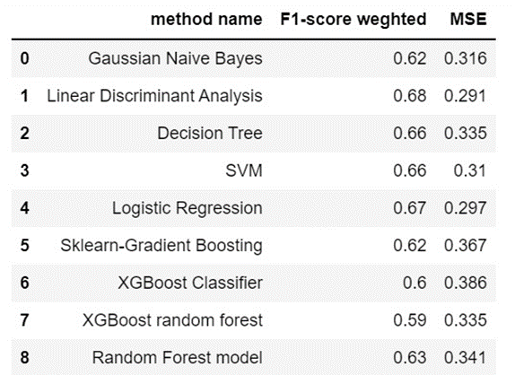
Results

Slide 22
Discussion
Limitations
Data quality - once real-world settings are more likely to lead to reduced data quality. Low sample size related to the fact that we only used information from one hospital Data available from the period of april 2020 to december 2021, inclusive, could not be used, because the number of hospital admissions was highly influenced by the COVID-19 pandemic.

Slide 23
Thank you!
“Education is the most powerful weapon which you can use to change the world.”
Nelson Mandela
Sponsored by:

